Slide 1
Labels 101:
Selling
866.516.7300
customerservice@idimages.com
www.idimages.com

Slide 2
Questions To
Ask Yourself
Why would I want to lead with SELLING LABELS?
Answer: You’re already providing their packaging materials, “Labels Make the Total Package”
Do you currently sell labels to your largest customers?
Answer: Should be YES and if you are not, ask yourself WHY?
Overcome both internal and external challenges that keep you from servicing this everyday need your customer is purchasing with your competition
Do you have any customers in manufacturing, logistics or distribution?
Answer: If yes, TARGET these accounts for large volume label sales
How can I differentiate myself from my competition?
Answer: Offer value and added convenience by limiting their sources for products you can already provide
Offer programs to save your customers money
Listen to your “customer’s pain” and create label and ribbon solutions

Slide 3
How Do I Sell Labels?
Most Important: Be aware of your customers’ needs
Labels are needed EVERYWHERE!
Do your customers receive products?
Do your customers inventory products?
Do your customers manufacture products?
Do your customers ship products?
If YOU are not selling labels to your customer, your COMPETITION IS! What else do you want them to sell YOUR customer?
4 basic questions to be asking your customer:
Explain the application and what is the label being applied to?
What application and service temp will the label be applied?
Environment: Will it be exposed to heat or cold? Humidity and moisture? Will grease, oil, sunlight, caustic chemicals, or other factors affect durability? Does it need to be a permanent label or removable and easily peeled off?
Applying the label: Will this label be affixed by machine or by hand? Is variable imprinting required?

Slide 4
Achieving The
Best Results
Achieving successful results with printed labels is a matter of
both planning and preparation.
Discuss the product with ID Images -- your printing supplier, as early in the process as possible.
Overcome challenges by thinking of them as OPPORTUNITIES!
Product Knowledge
Knowing the questions to ask regarding printers and labels
Pricing
Minimums
Tooling charges
Misconception that there is little margin to be made in selling labels
Open Discussion From Questionnaire Results.

Slide 5
Delivering Expanded Services With Proven Results
We are here to help!
Sales Calls
We will help in supporting with end user calls
You qualify the account
Set up the appointment with their contacts
Products we provide will be quoted
Final step being VITAL is to follow up with customer while its still hot
Qualifying the Account
Role Play
Literature: Customizing marketing collateral
Used for Handouts as leave behinds
E-blasts on new products or promotions
Customized price list with a full list of stock label and ribbon products you can provide
Training
We provide training both here at ID Images as well as your facility

Slide 6
Paper Labels
Segments that use paper labels:
Manufacturing
Distribution
Warehouse
Retail
Healthcare
Food Industries
Your existing customers

Slide 7
Durable Film Labels
End-User Market Applications
Electronics
Appliance-UL approved
Healthcare
Computers & PDA’s
Cell Phones
Circuit Boards
HVAC
Power Tools
White & Brown Goods
Medical Diagnostics
Pharmaceuticals
Bandages
Lawn & Garden
Transportation
Sports & Leisure
Outdoor Power Equipment
Ladders
Furniture
Automotive Underhood
Tires & Batteries
Safety Systems & Interiors
Sports Equipment
Outboard Motors
Toys

Slide 8
Keys To Success
Utilize OUR services to build business together
Identify large users of labels
Warehouse walk-through
Shipping docks
Work in process inventory
Distribution companies
Identify the buyer or decision maker
Purchasing
Operations Manager
Warehouse/Shipping Manager
Information Technology
Compliance Manager
Quality Department
Printer Operators
They are a good source to let you know how the existing product is working which can be difficult to get from Purchasing

Slide 9
Keys To Success
Build relationships by Knowing Your Customers’ Needs
Offer one of our Cost-Savings Programs outlining their benefits
We are happy to provide free stock samples
For custom sizes, we will work with you
We can service national accounts
“Win” one facility and target the rest

Slide 10
Marketing Services
Your Dedicated Distribution Partner
Building Business Together

Slide 11
Marketing Services
We Offer a Range of Marketing Services:
Marketing Collateral
Product / Market Sell Sheets
Product Catalogs
eMarketing Campaigns
Product Promotions
Informational Campaigns
Public Relations
Success Stories
News Releases
Creative & Other Services
Design
Images (print & web applications)

Slide 12
Marketing Services
Benefits of our Marketing Services:
Tools to Assist in the Selling Process
Educate Your Customers
Build Awareness and Credibility
Effective Method to Stay in Front of Customer
Track and Measure Success (eMarketing)
Tailor Information Based on Customer Type
SELL MORE LABELS & RIBBONS

Slide 13
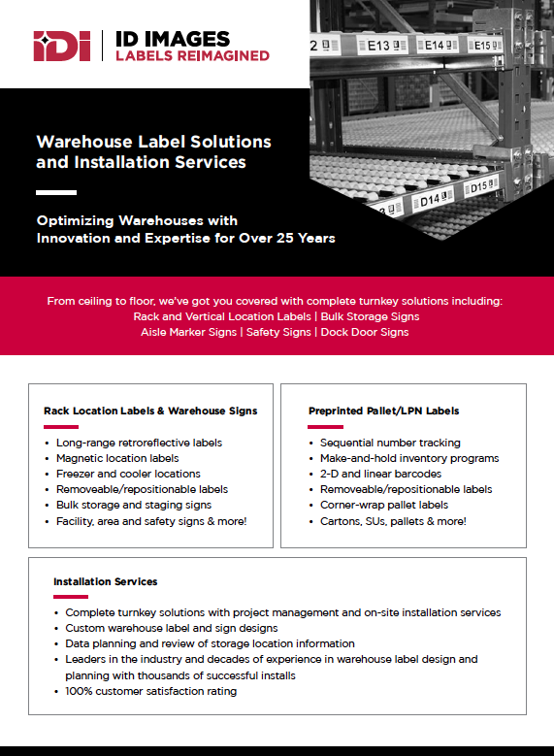
Marketing Collateral
Logo
Generic Product Sell Sheet
Company Logo
Customize content based on need
Company Contact Information

Slide 14
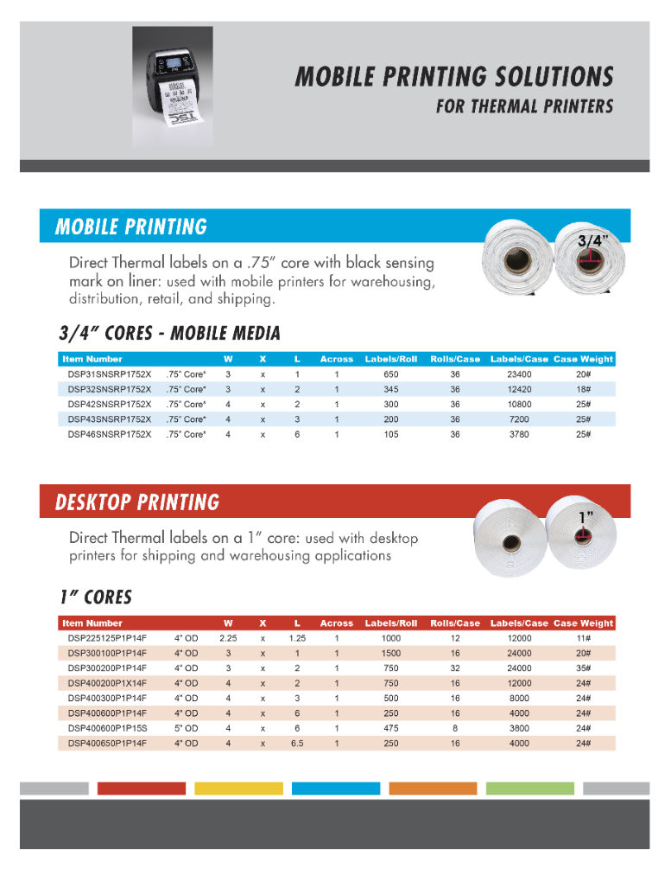
Marketing
Collateral
Customized brochure to promote specific product, service or capability.

Slide 15
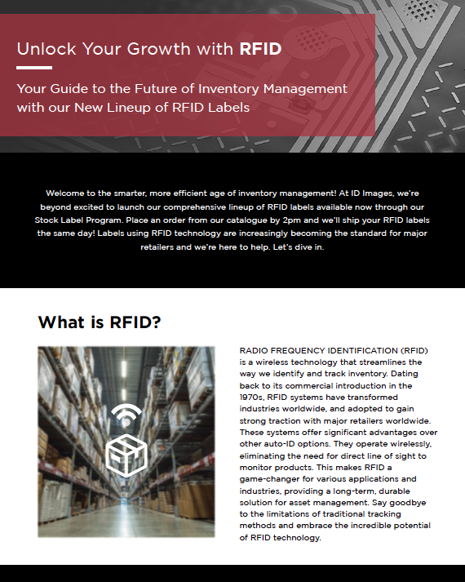
Marketing
Collateral
Specialty Brochures
Customized message & images

Slide 16
Thank You
Call or email ID Images today 866.516.7300 customerservice@idimages.com www.idimages.com

