Slide 1
Labels 101:
Label Components
866.516.7300
customerservice@idimages.com
www.idimages.com

Slide 2
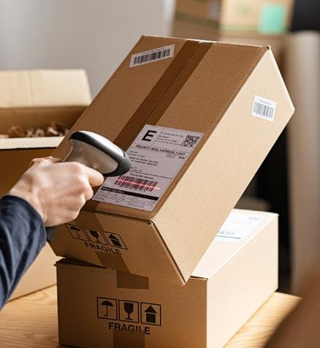
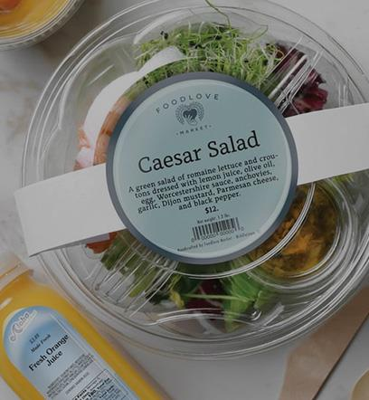
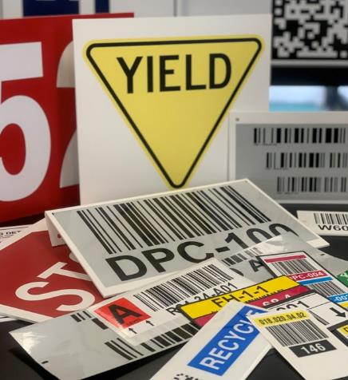
Labels Make the Total Package
No package is complete without the label. At ID Images we know label requirements. We can run custom up to 8 colors as well as supply the stock labels you need. We deliver what you require to ensure your future business; on-time delivery, unmatched quality and competitive pricing. Let us provide solutions for your product identification needs.

Slide 3
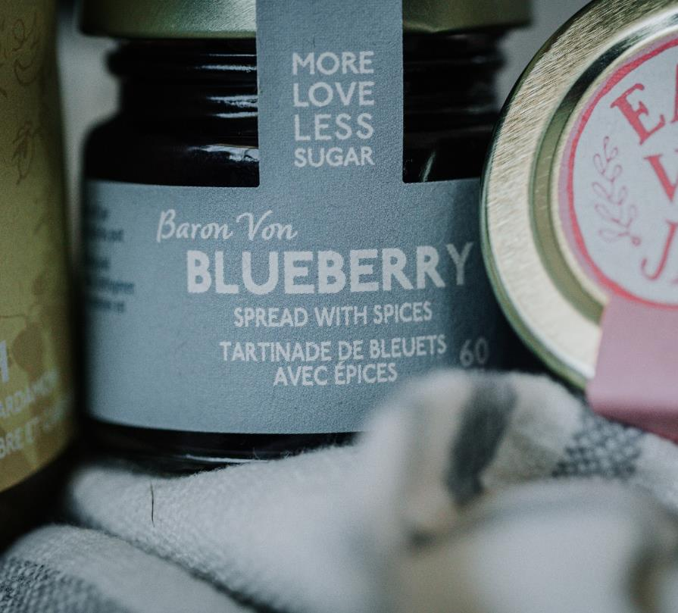
What is a label?
Simply put, a label provides information about a product
Barcode
Address
Ingredients
Product Name / Marketing Information
Other uses
Labels come in many varieties for different aesthetic looks and practical purposes
The following criteria should be reviewed when determining your customers’ label needs:
Label stock materials
The processes of label manufacturing
How labels are applied in order to decide what meets your customers’ needs

Slide 4
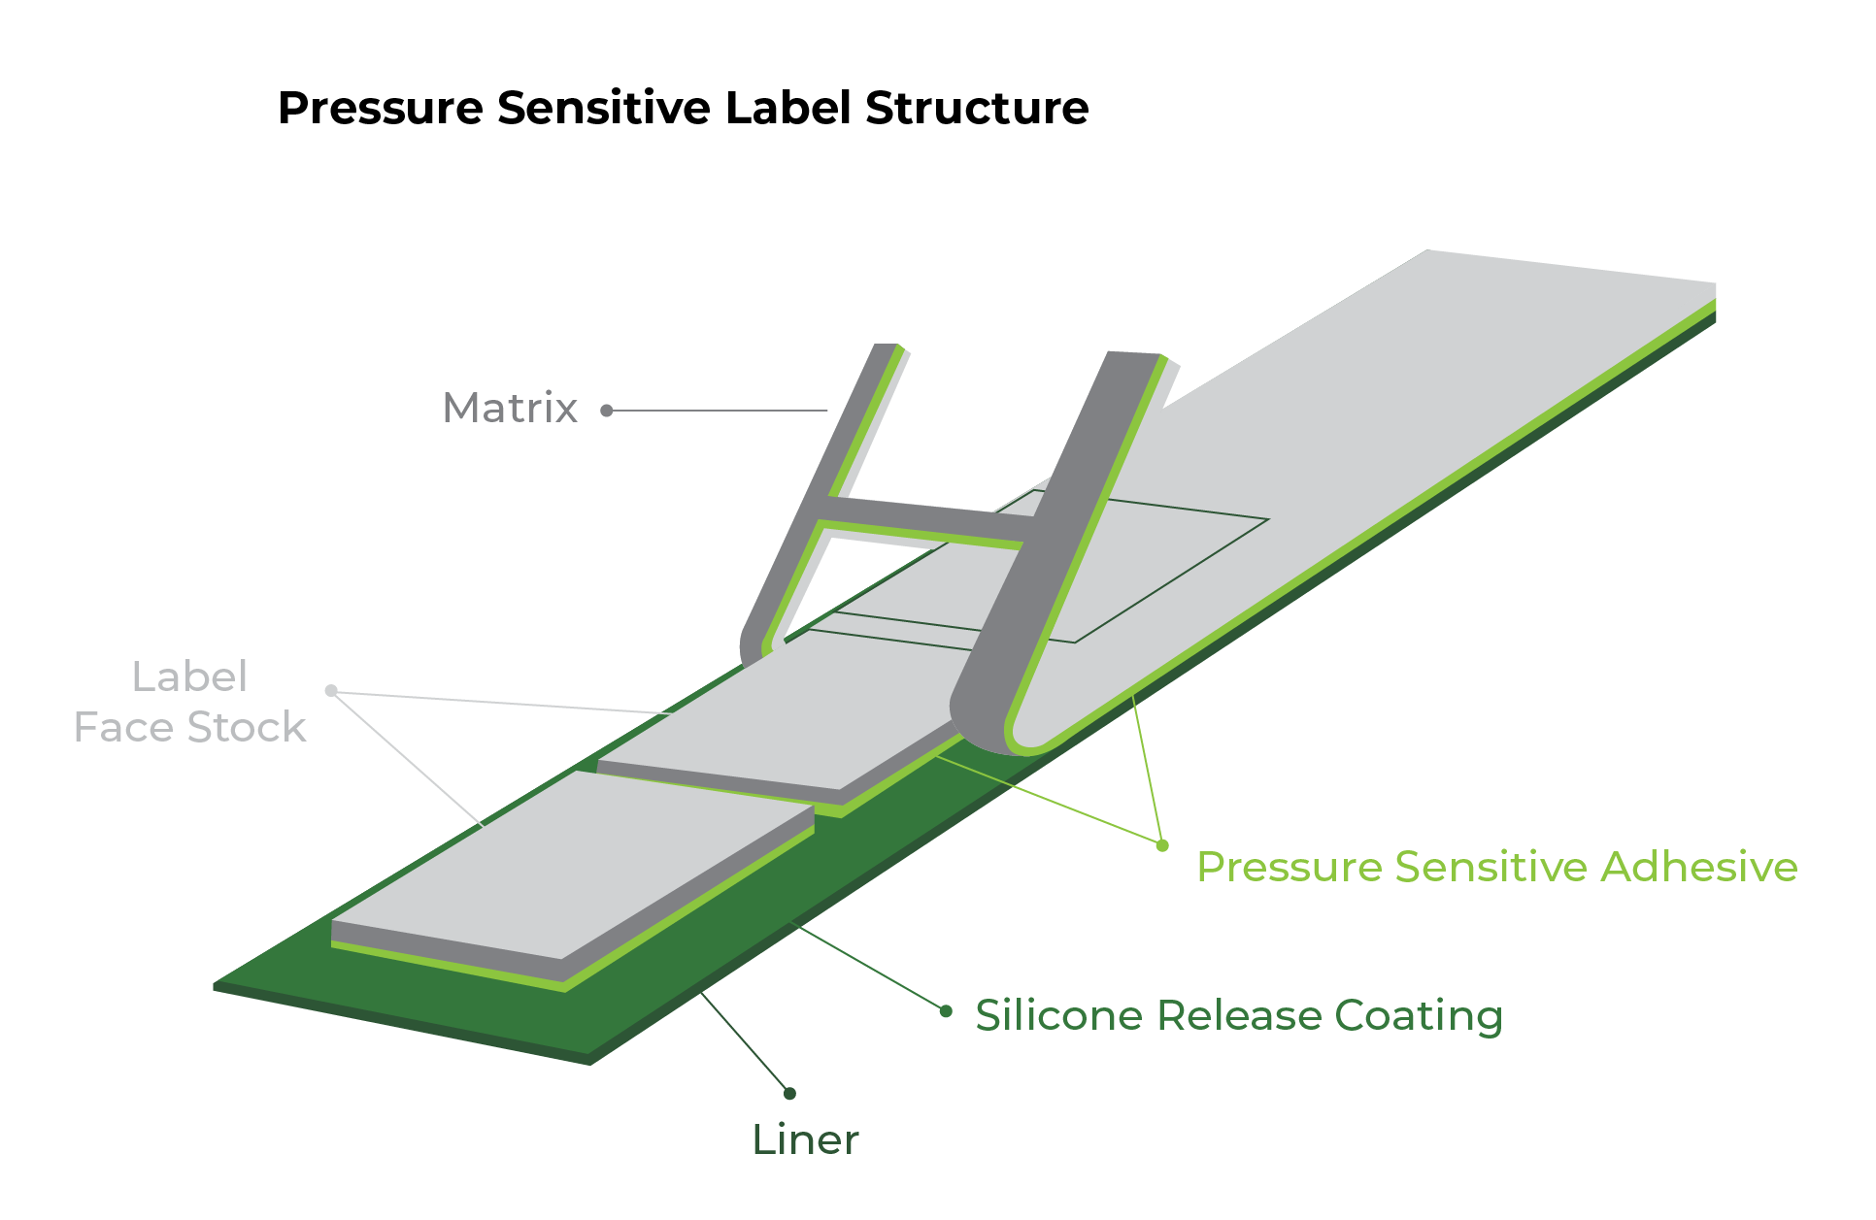
Understanding the
Components of a Label
There are five components to every label:
Topcoat or laminate (this is optional)
Face stock
Adhesive
Backing or liner
Substrate (what the label is going to adhere to)
All five components have characteristics that affect end use.

Slide 5
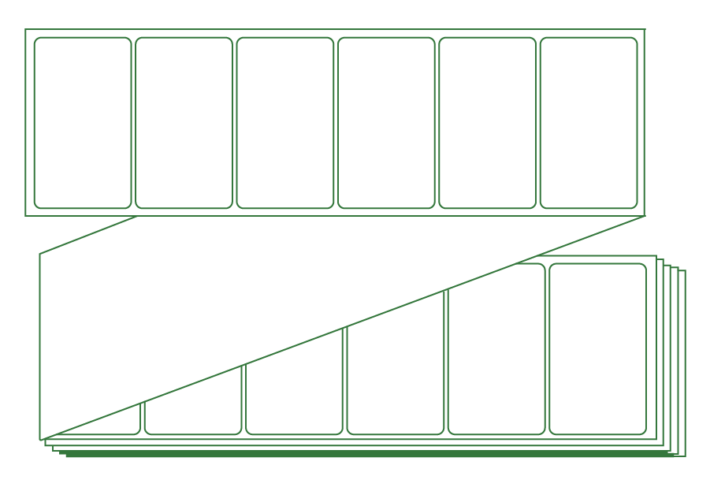
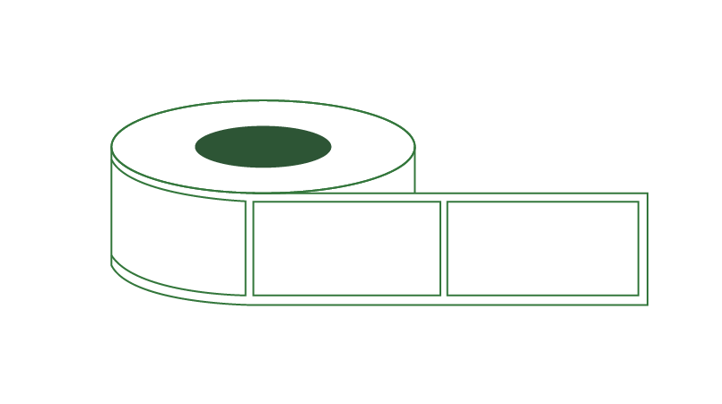
Label
Configurations
Put-Ups
ROLLS
Labels produced on a continuous roll
FANFOLD
Continuous fanfold
SHEETS
Labels in sheeted form

Slide 6
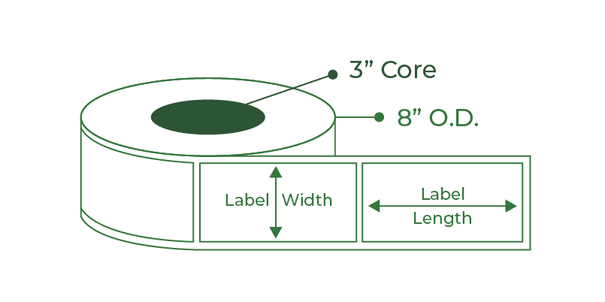
Label
Configurations
Measuring Label Size
Standard Finished Roll Put Up shown below – Fanfold labels are measured the same without the core or OD
Width x Length ( Ex. 4 x 6 with 3” core and 8” OD)
Laser Inkjet Sheets
Standard Sheet Size 8.5 x 11 or 8.5 x 14
Commonly referred as # of labels across and # of labels down
Example shown: 3across and 10 down or a 30-up laser sheet

Slide 7
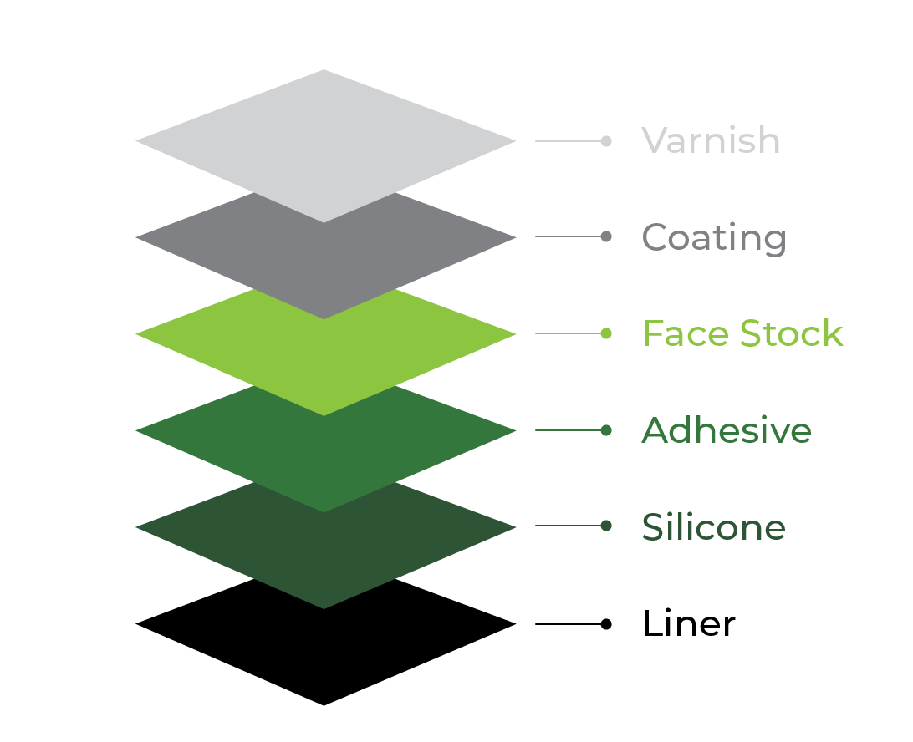
Label Face Stock
Face stocks come in a variety of finishes- Both uncoated and coated
Thermal transfer
Direct thermal
Laser
Film
Paper
Paper is versatile, economical, easy-to print and can be die cut into any shape.
Pressure sensitive (PS) Film Labels
Pressure sensitive (PS) film labels are constructed and work the same way as paper, but the face stock is film
Film Labels
Film labels are good for applying to curved surfaces. They work especially well in packaging that is handled and squeezed because these labels flex and are durable

Slide 8
Label
Face Stock
Another important aspect of pressure-sensitive labels is that the roll label variety can be used with automatic applicators to adhere the labels to the substrate surface. This means faster application time and less cost than hand application.

Slide 9
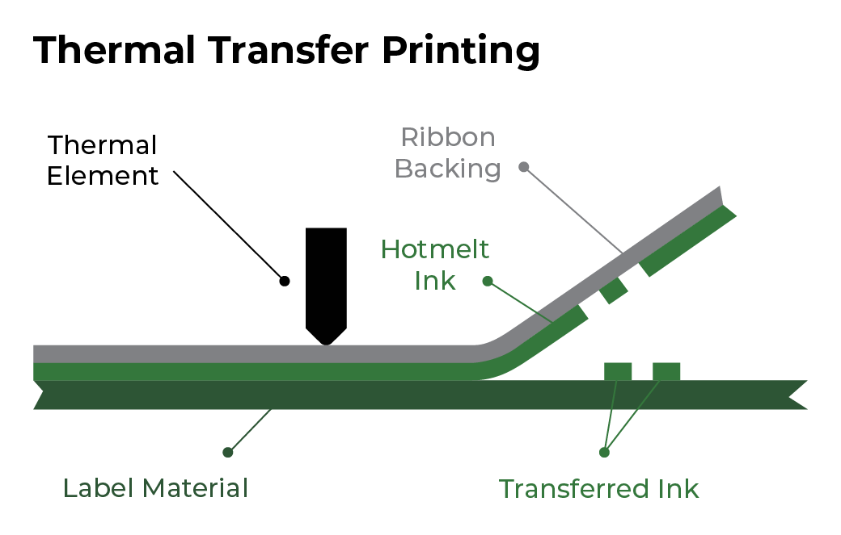
Primary Paper
Label Face Stocks
Thermal Transfer
Thermal transfer label components use a face paper specifically designed to accept heat activated ink from the ribbon of a thermal transfer printer
A heated matrix head allows transfer of pigment to face stock
Frequently used for bar-coded labels
Direct Thermal
Direct Thermal face stock is either top-coated for resistance to environmental conditions, or non-top coated for dry applications
The material darkens when heated and has a high-resolution printing but the face stock continues to heat and deteriorates in contrast over time
Best for short-term durability
Suitable for bar coded labels
Applications now being widely used in the health care / pharmaceutical industry

Slide 10
Primary Paper
Label Face Stocks
Laser
Paper material that uses heat and pressure to fuse a powered toner or “ink” to the material on which user is printing .
High-resolution printing, and prime labels – primarily for consumer products/promotions.
Equipment ranges from inexpensive desktop to very expensive high speed.
Suitable for bar codes.

Slide 11
Variable Information Printing Film Media
Variable Information Printing film media is available for thermal transfer, direct thermal, laser and inkjet printing technologies
Film label face stocks provide far greater durability than that of paper labels and are used in a wide range of markets including industrial, retail, food and healthcare to name a few.
Primary Benefits
Primary Films
Durability
Environmental resistance
Increased strength
Tear resistance
Top-coated BOPP
Polypropylene
Polyethylene
Vinyl
Polyester

Slide 12
Primary Applications
Of Film Media
TC BOPP
Polythelyne (Kimdura)
Increased strength & environmental resistance.
Used in box/carton labeling (food processing - poultry --unique in that poultry plants kill to packaging in one plant),
Baggage tags/ski lift
Limited shelf marking
Excellent tear resistance and high opacity
Container placards
Safety
Applications requiring high durability
Polypropylene
Vinyls (white & frosty clear)
Great TT imaging, durability
Automotive (inside car)
Meat packaging
Cheese
Good laser printing characteristics
Shelf talkers
Shelf labeling

Slide 13
Label Liner
Label carrier paper, also called the backing or liner, is not ordinarily specified by end users
Most backing is treated with a silicone coating on the white kraft paper in order to provide easy removal of labels from the carrier
There are a variety of labels created for very specific applications to include:
Label sheets that work in laser printers
Barcode labels for inventory tracking and pricing
Retail price labels for clothing to identify branding and washing instructions
CD and DVD labels; as well as tamper-resistant, tamper-evident, and other security labels that help protect consumers

Slide 14
Label Adhesive
Pressure Sensitive Adhesive (PSA) :
A non-structural adhesive that provides instant tackiness to a variety of surfaces and requires minimal pressure to stick to a surface.
The strength and stickiness of a label adhesive is dependent upon two factors: tack and adhesion.
Tack is the stickiness of the label when it initially attaches to an item – at the point of adhesion
Adhesion and the strength of adhesion, relates to the stickiness of the label when the adhesive sets
One of the basic choices when ordering a label is to understand what type of adhesive your customer’s application requires.

Slide 15
Permanent Adhesive
Permanent adhesives are typically specified for most applications.
They display good bonding characteristics and withstand most environmental conditions; however, performance depends on the surface to which they are applied.
Permanent Adhesive
Types Available
Acrylic
Excellent adhesion to paper, painted metal, glass and high surface energy plastics.
Not recommended for textured surfaces, wax cartons, porous surfaces or low surface energy plastics.

Slide 16
Permanent Adhesive Types Available
BLOCK-OUT
ALL TEMP/FREEZER
Aggressive high-tack permanent adhesive with a special opaque barrier coating that allows the label to be applied over existing labels for correction
This barrier coat prevents bar codes on the original label to be inadvertently scanned through the top correction label
A special adhesive that can be applied to surfaces at temperatures as low as -20° F
It has good initial tack and high ultimate adhesion
Performs well on low surface energy plastics and has good permanency at temperatures from -65° F to 160° F

Slide 17
Permanent Adhesive Types Available
INDIRECT FOOD CONTACT
RUBBER-BASED
Outstanding general-purpose permanent adhesive, which has high initial tack and high ultimate adhesion.
Application temperature +25° F.
Service temperature range: -65° F to +220° F.
Superior performance on corrugated, paper, painted metal, glass, and packaging film.
Works well on curved surfaces for application to silk or other fabric
Adhesive designed to adhere to fresh fruits and vegetables with edible skins.
Good initial tack and adhesion.

Slide 18
Permanent Adhesive Types Available
TIRE ADHESIVE
LONG-TERM
Highly aggressive permanent adhesive designed specifically for tire label applications.
It has high initial tack, shear and ultimate adhesion.
Provides excellent performance on hard to label substrates such as wood and carpet backing.
Usually, a removable adhesive is recommended when a label has a short-term life or is applied to a surface that could be damaged by the adhesive.
A general-purpose removable adhesive featuring moderate tack and clean removability from many substrates for up to 6 months.
ULTRA
A removable adhesive with ultra low-tack, adhesion, and shear properties
Has a service temperature range of -20° F to +250° F, and is removable without leaving residue

Slide 19
Know Your
Customers’ Application
Understand what type of questions to ask in knowing what type of surface the label will be applied to:
Substrate Composition:
What type of substrate do you intend to label?
There are a wide variety of substrate compositions that react differently to adhesive types.
Substrate Shape and Texture:
Is the substrate flat or curved?
Is the texture smooth or rough?
Shape and texture presents additional challenges for adhesives because less surface contact results in a smaller bonding area and lower adhesion levels.
What is the contour of the object to which the label is applied is a primary consideration .
Regardless of the adhesive strength, it is virtually impossible for an
adhesive to overcome continuous stress if the right face stock (conformable) is
not chosen.

Slide 20
Know Your
Customer's Application
End-Use Environment
What type of conditions will the labeled product be used in?
Environmental conditions play a pivotal role in the selection of adhesives.
Conditions to consider:
Will the surface be clean, free of dust?
Will the surface have oil or moisture?
Will the surface be rough or smooth, curved or flat?
Will the surface be affected by heat or cold?
The presence of contamination can prevent contact of the adhesive with the substrate.
We ALWAYS recommend sampling the label in your customers’ end-use environment.

Slide 21
Thank You
Call or email ID Images today 866.516.7300 customerservice@idimages.com www.idimages.com

