Slide 1
Labels 101 Training
866.516.7300
customerservice@idimages.com
www.idimages.com

Slide 2
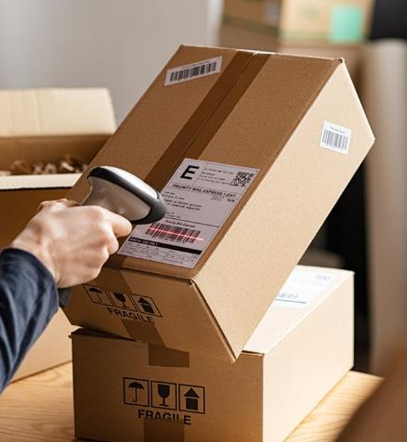
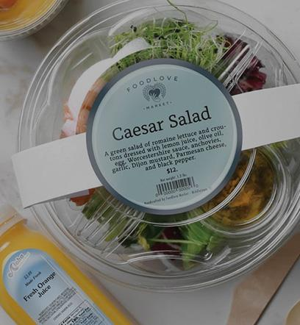
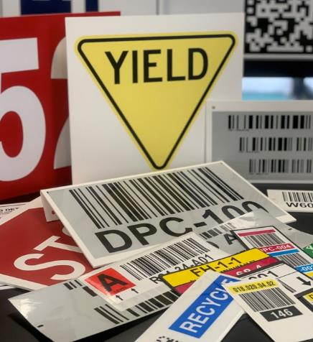
Labels Make the Total Package
No package is complete without the label. At ID Images we know label requirements. We can run custom up to 8 colors as well as supply the stock labels you need. We deliver what you require to ensure your future business; on-time delivery, unmatched quality and competitive pricing. Let us provide solutions for your product identification needs.

Slide 3
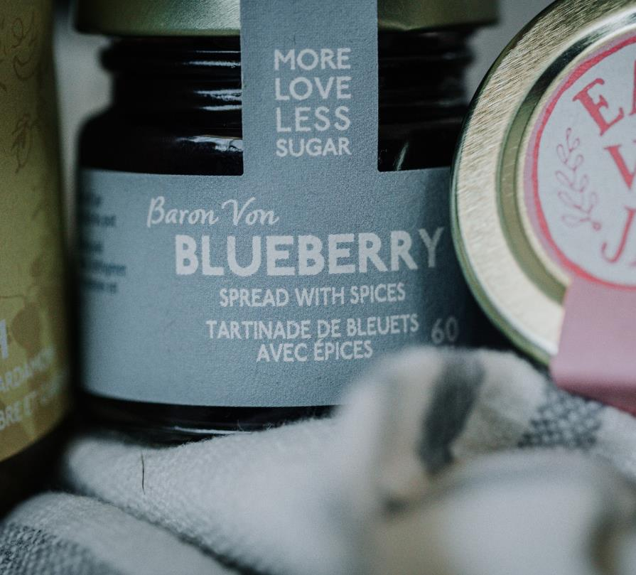
What is a label?
Simply put, a label provides information about a product
Barcode
Address
Ingredients
Product Name / Marketing Information
Other uses
Labels come in many varieties for different aesthetic looks and practical purposes
The following criteria should be reviewed when determining your customers’ label needs:
Label stock materials
The processes of label manufacturing
How labels are applied in order to decide what meets your customers’ needs

Slide 4
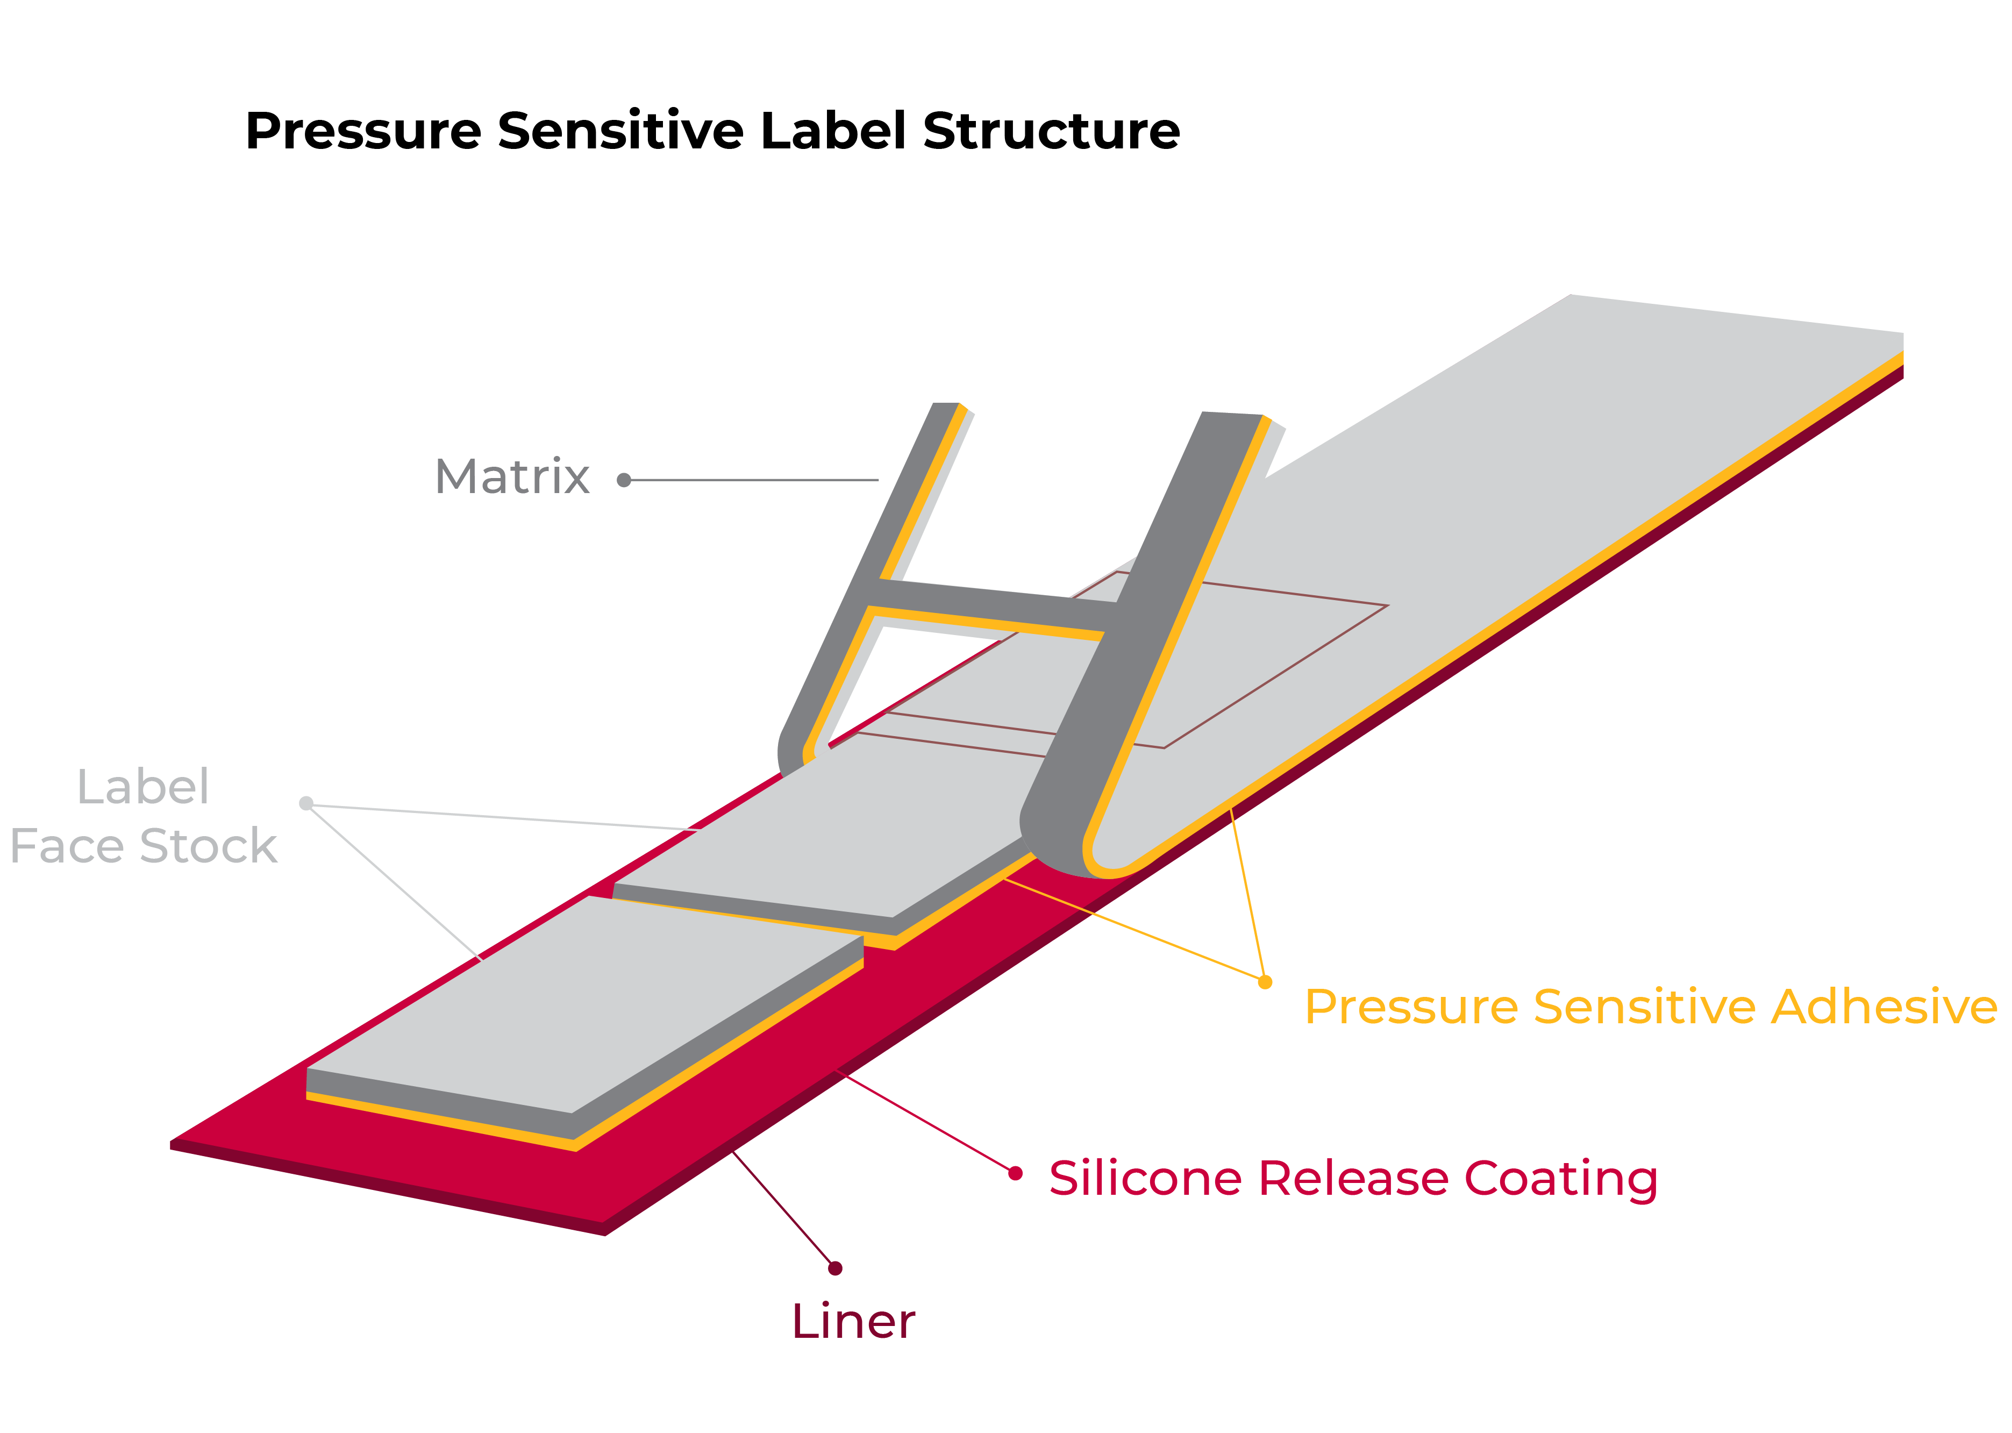
Understanding the
Components of a Label
There are five components to every label:
Topcoat or laminate (this is optional)
Face stock
Adhesive
Backing or liner
Substrate (what the label is going to adhere to)
All five components have characteristics that affect end use.

Slide 5
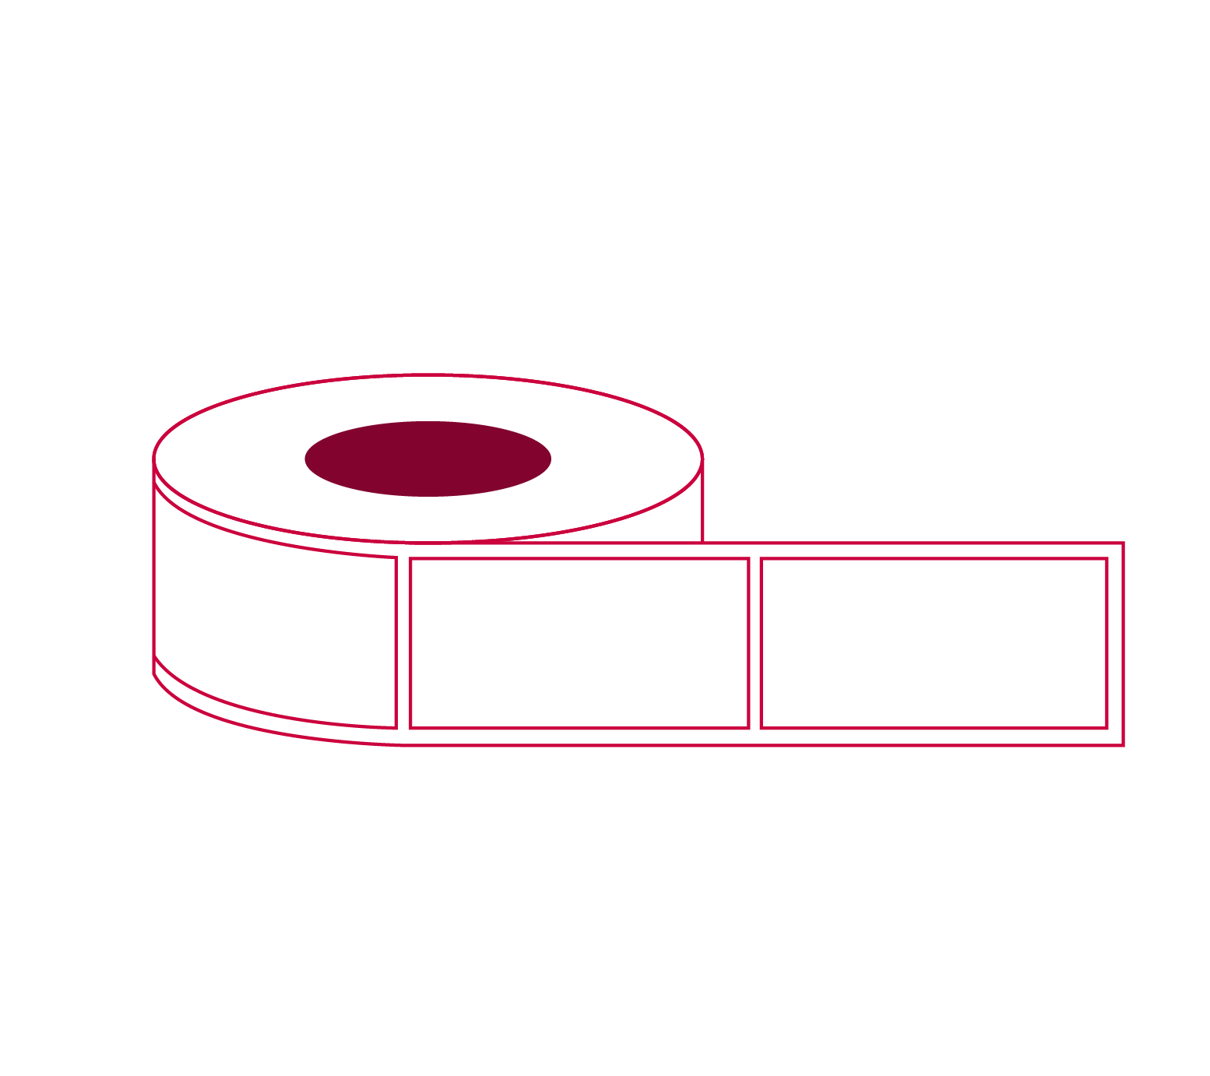
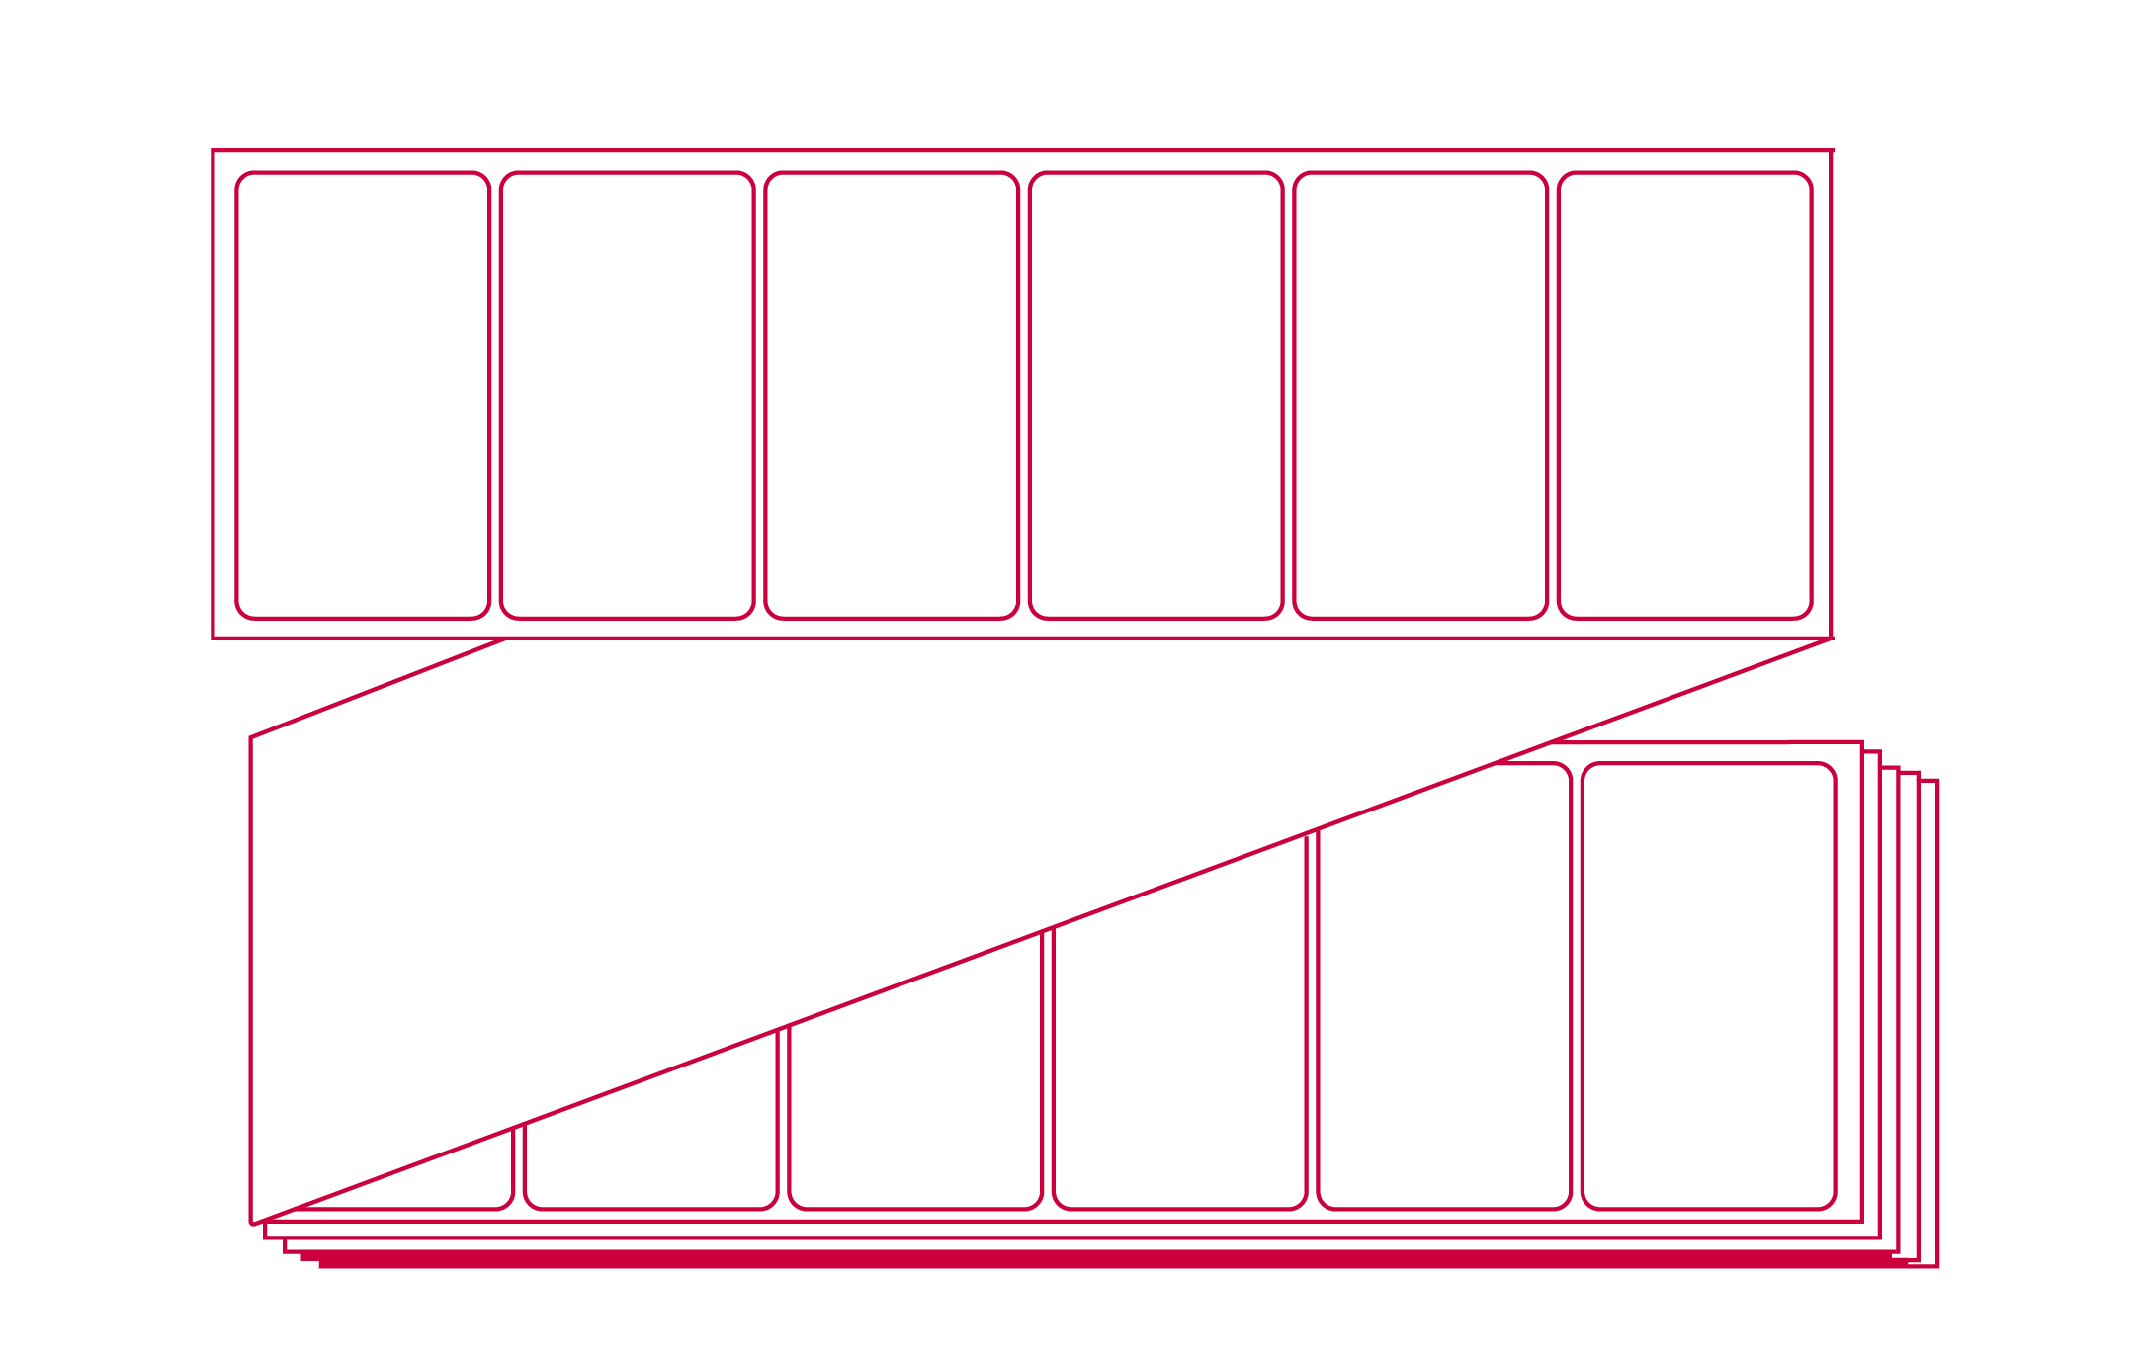
Label
Configurations
Put-Ups
ROLLS
Labels produced on a continuous roll
FANFOLD
Continuous fanfold
SHEETS
Labels in sheeted form

Slide 6
Label
Configurations
Measuring Label Size
Standard Finished Roll Put Up shown below – Fanfold labels are measured the same without the core or OD
Width x Length ( Ex. 4 x 6 with 3” core and 8” OD)
Laser Inkjet Sheets
Standard Sheet Size 8.5 x 11 or 8.5 x 14
Commonly referred as # of labels across and # of labels down
Example shown: 3across and 10 down or a 30-up laser sheet

Slide 7
Label Face Stock
Face stocks come in a variety of finishes- Both uncoated and coated
Thermal transfer
Direct thermal
Laser
Film
Paper
Paper is versatile, economical, easy-to print and can be die cut into any shape.
Pressure sensitive (PS) Film Labels
Pressure sensitive (PS) film labels are constructed and work the same way as paper, but the face stock is film
Film Labels
Film labels are good for applying to curved surfaces. They work especially well in packaging that is handled and squeezed because these labels flex and are durable

Slide 8
Label
Face Stock
Another important aspect of pressure-sensitive labels is that the roll label variety can be used with automatic applicators to adhere the labels to the substrate surface. This means faster application time and less cost than hand application.

Slide 9
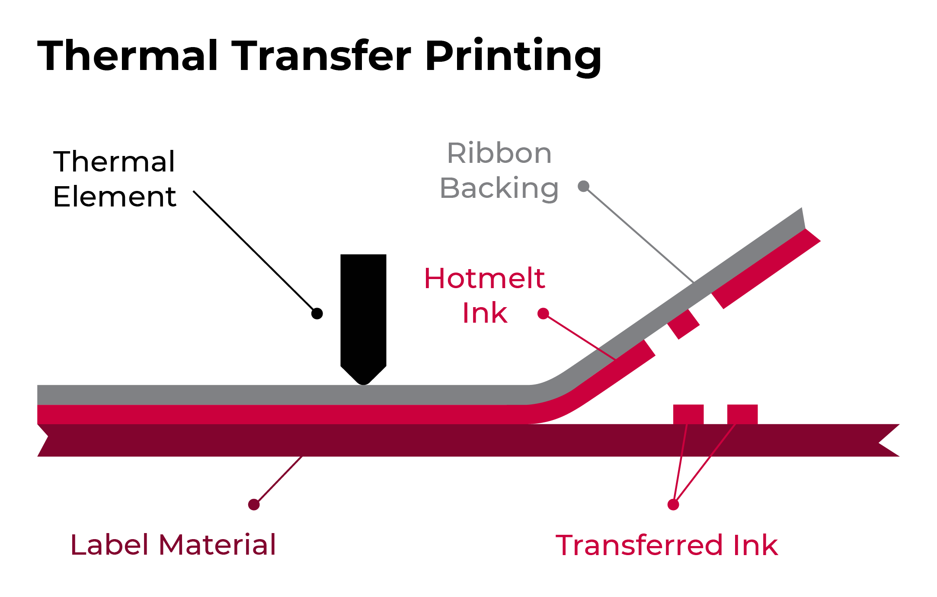
Primary Paper
Label Face Stocks
Thermal Transfer
Thermal transfer label components use a face paper specifically designed to accept heat activated ink from the ribbon of a thermal transfer printer
A heated matrix head allows transfer of pigment to face stock
Frequently used for bar-coded labels
Direct Thermal
Direct Thermal face stock is either top-coated for resistance to environmental conditions, or non-top coated for dry applications
The material darkens when heated and has a high-resolution printing, but the face stock continues to heat and deteriorates in contrast over time
Best for short-term durability
Suitable for bar coded labels
Applications now being widely used in the health care / pharmaceutical industry

Slide 10
Primary Paper
Label Face Stocks
Laser
Paper material that uses heat and pressure to fuse a powered toner or “ink” to the material on which user is printing .
High-resolution printing, and prime labels – primarily for consumer products/promotions.
Equipment ranges from inexpensive desktop to very expensive high speed.
Suitable for bar codes.

Slide 11
Variable Information Printing Film Media
Variable Information Printing film media is available for thermal transfer, direct thermal, laser and inkjet printing technologies
Film label face stocks provide far greater durability than that of paper labels and are used in a wide range of markets including industrial, retail, food and healthcare to name a few.
Primary Benefits
Primary Films
Durability
Environmental resistance
Increased strength
Tear resistance
Top-coated BOPP
Polypropylene
Polyethylene
Vinyl
Polyester

Slide 12
Primary Applications
Of Film Media
TC BOPP
Polythelyne (Kimdura)
Increased strength & environmental resistance.
Used in box/carton labeling (food processing - poultry --unique in that poultry plants kill to packaging in one plant),
Baggage tags/ski lift
Limited shelf marking
Excellent tear resistance and high opacity
Container placards
Safety
Applications requiring high durability
Polypropylene
Vinyls (white & frosty clear)
Great TT imaging, durability
Automotive (inside car)
Meat packaging
Cheese
Good laser printing characteristics
Shelf talkers
Shelf labeling

Slide 13
Label Liner
Label carrier paper, also called the backing or liner, is not ordinarily specified by end users
Most backing is treated with a silicone coating on the white kraft paper in order to provide easy removal of labels from the carrier
There are a variety of labels created for very specific applications to include:
Label sheets that work in laser printers
Barcode labels for inventory tracking and pricing
Retail price labels for clothing to identify branding and washing instructions
CD and DVD labels; as well as tamper-resistant, tamper-evident, and other security labels that help protect consumers

Slide 14
Label Adhesive
Pressure Sensitive Adhesive (PSA) :
A non-structural adhesive that provides instant tackiness to a variety of surfaces and requires minimal pressure to stick to a surface.
The strength and stickiness of a label adhesive is dependent upon two factors: tack and adhesion.
Tack is the stickiness of the label when it initially attaches to an item – at the point of adhesion
Adhesion and the strength of adhesion, relates to the stickiness of the label when the adhesive sets
One of the basic choices when ordering a label is to understand what type of adhesive your customer’s application requires.

Slide 15
Permanent Adhesive
Permanent adhesives are typically specified for most applications.
They display good bonding characteristics and withstand most environmental conditions; however, performance depends on the surface to which they are applied.
Permanent Adhesive
Types Available
Acrylic
Excellent adhesion to paper, painted metal, glass and high surface energy plastics.
Not recommended for textured surfaces, wax cartons, porous surfaces or low surface energy plastics.

Slide 16
Permanent Adhesive Types Available
BLOCK-OUT
ALL TEMP/FREEZER
Aggressive high-tack permanent adhesive with a special opaque barrier coating that allows the label to be applied over existing labels for correction
This barrier coat prevents bar codes on the original label to be inadvertently scanned through the top correction label
A special adhesive that can be applied to surfaces at temperatures as low as -20° F
It has good initial tack and high ultimate adhesion
Performs well on low surface energy plastics and has good permanency at temperatures from -65° F to 160° F

Slide 17
Permanent Adhesive Types Available
INDIRECT FOOD CONTACT
RUBBER-BASED
Outstanding general-purpose permanent adhesive, which has high initial tack and high ultimate adhesion.
Application temperature +25° F.
Service temperature range: -65° F to +220° F.
Superior performance on corrugated, paper, painted metal, glass, and packaging film.
Works well on curved surfaces for application to silk or other fabric
Adhesive designed to adhere to fresh fruits and vegetables with edible skins.
Good initial tack and adhesion.

Slide 18
Permanent Adhesive Types Available
TIRE ADHESIVE
LONG-TERM
Highly aggressive permanent adhesive designed specifically for tire label applications.
It has high initial tack, shear and ultimate adhesion.
Provides excellent performance on hard to label substrates such as wood and carpet backing.
Usually, a removable adhesive is recommended when a label has a short-term life or is applied to a surface that could be damaged by the adhesive.
A general-purpose removable adhesive featuring moderate tack and clean removability from many substrates for up to 6 months.
ULTRA
A removable adhesive with ultra low-tack, adhesion, and shear properties
Has a service temperature range of -20° F to +250° F, and is removable without leaving residue

Slide 19
Know Your
Customers’ Application
Understand what type of questions to ask in knowing what type of surface the label will be applied to:
Substrate Composition:
What type of substrate do you intend to label?
There are a wide variety of substrate compositions that react differently to adhesive types.
Substrate Shape and Texture:
Is the substrate flat or curved?
Is the texture smooth or rough?
Shape and texture presents additional challenges for adhesives because less surface contact results in a smaller bonding area and lower adhesion levels.
What is the contour of the object to which the label is applied is a primary consideration .
Regardless of the adhesive strength, it is virtually impossible for an
adhesive to overcome continuous stress if the right face stock (conformable) is
not chosen.

Slide 20
Know Your
Customer's Application
End-Use Environment
What type of conditions will the labeled product be used in?
Environmental conditions play a pivotal role in the selection of adhesives.
Conditions to consider:
Will the surface be clean, free of dust?
Will the surface have oil or moisture?
Will the surface be rough or smooth, curved or flat?
Will the surface be affected by heat or cold?
The presence of contamination can prevent contact of the adhesive with the substrate.
We ALWAYS recommend sampling the label in your customers’ end-use environment.

Slide 21
Thermal Transfer Ribbons
TTR101 Training

Slide 22
What Is Thermal
Transfer Printing?
Thermal Transfer:
An on-demand printing technology where there is transfer of ink from a base film to a label substrate using heat, pressure, and speed.
Requirements:
Thermal Transfer Printer
Thermal Transfer Ribbon (TTR)
Thermal Transfer Compatible Label Stock

Slide 23
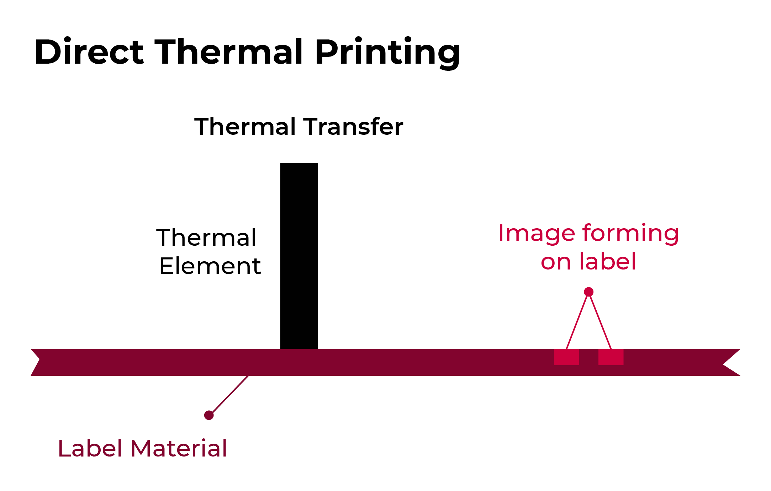
Direct Thermal VS
Thermal Transfer
Direct Thermal
No thermal ribbon required – heat activated paper
Requires higher heat than TT
No buffer to keep label from contacting printhead
Printhead will burn out faster than with TT
Limited in scope
Thermal Transfer
Thermal ribbon protects printhead from label material
Requires less heat to transfer ink from ribbon to label
Printhead will last longer with TT
More flexible solution – Paper, synthetics, films

Slide 24
WAX
WAX / RESIN
RESIN
Thermal Ribbon
Formulations

Slide 25
Wax
General Specifications:
Will be the solution 85% of the time
Prints at high speeds – up to 12IPS
Produces dark images
Provides durable image
Ability to print on flood coated labels
Typical Substrates:
Coated and uncoated tags
Papers and gloss paper
Polyethylene, Kimdura
Applications:
Corrugated and general carton labeling
Retail tags
Ingredient label and pharmacy labels
General ticketing
Apparel size marking/pricing
Lot tracking

Slide 26
Wax / Resin
General Specifications:
Prints on a wide variety of label stocks
Highly scratch and smudge resistant
Some chemical resistance
Excellent print quality on uncoated tags
Requires more heat than when printing with a wax ribbon
Typical Substrates:
Coated and uncoated tags
Varnished label stocks
Polyethylene, Polypropylene, Polyolefin, Matte Polyesters
Applications:
Clothing labels
Lumber tags, wire tags, tote labeling, ski lift tags, hunting tags and horticulture tags
Pharmaceutical vial and pill bottle labels and medical device labeling
Lot and part tracking

Slide 27
Resin
General Specifications:
Produces excellent barcodes and variable images at higher speeds
Higher durability than wax or wax/resin ribbons
Compatible with a vast array of substrates
UL recognized
Heat resistance – typically over 300°F
Requires more heat than when printing with a wax or wax/resin ribbon
Typical Substrates:
Synthetic Paper
PVC Cards
Polyester, Polyethylene, Polypropylene and Vinyl
Applications:
Shelf labels
Warning labels and tamper-evident labeling
Drum, component and automotive labels
Jewelry tags

Slide 28
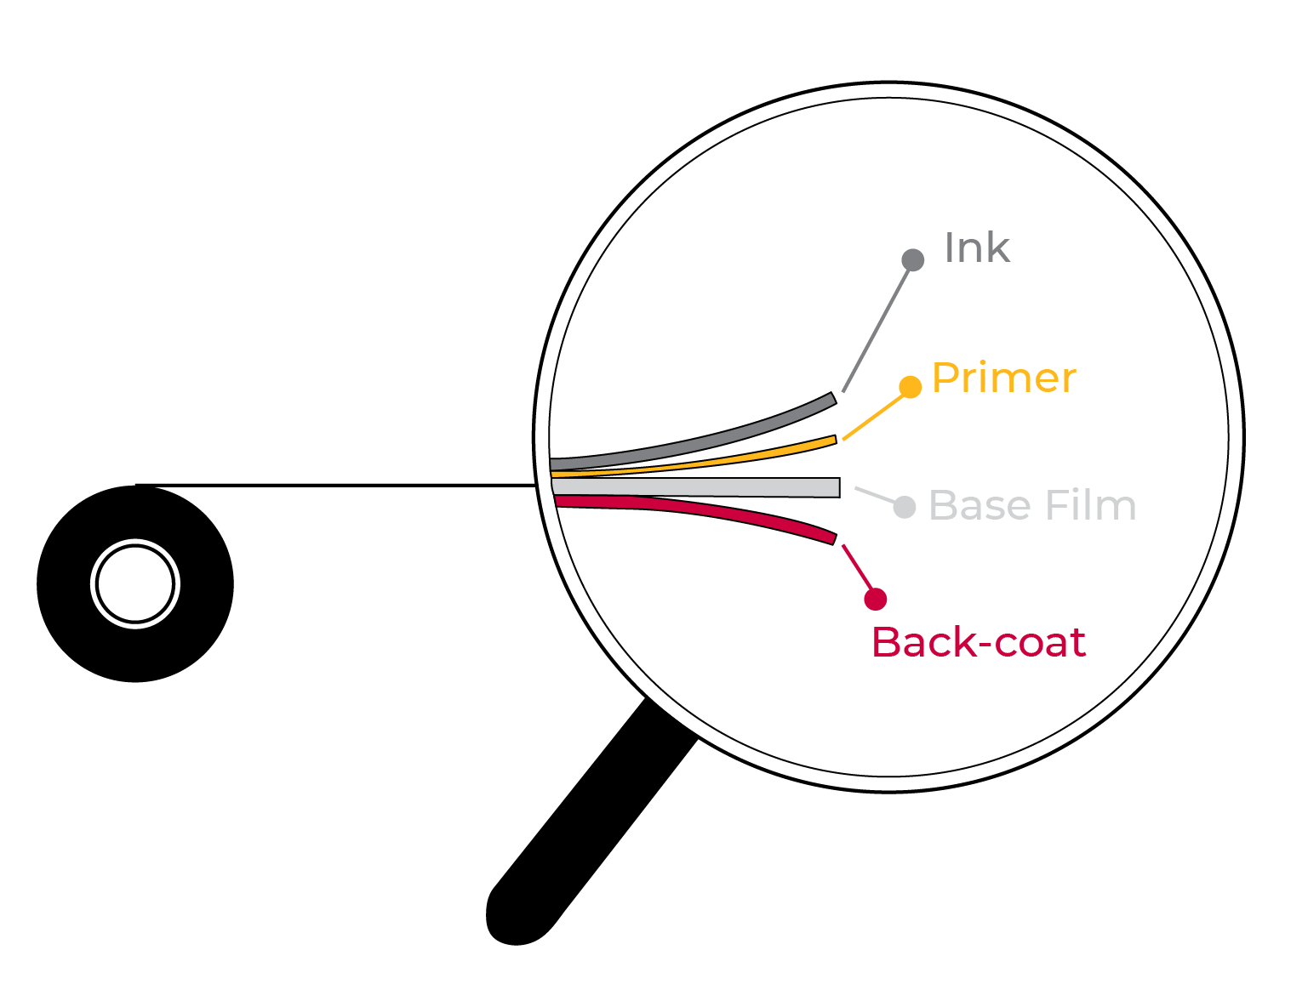
Thermal Transfer
Ribbon Construction
Structure and Imaging Components of a Thermal Transfer Ribbon
Base Film
PET - polyethylene terephthalate
Primer
Bonds the ink to the base film
Backcoat
Lubricating agent which protects the print head
Ink Layer
Creates the printed image

Slide 29
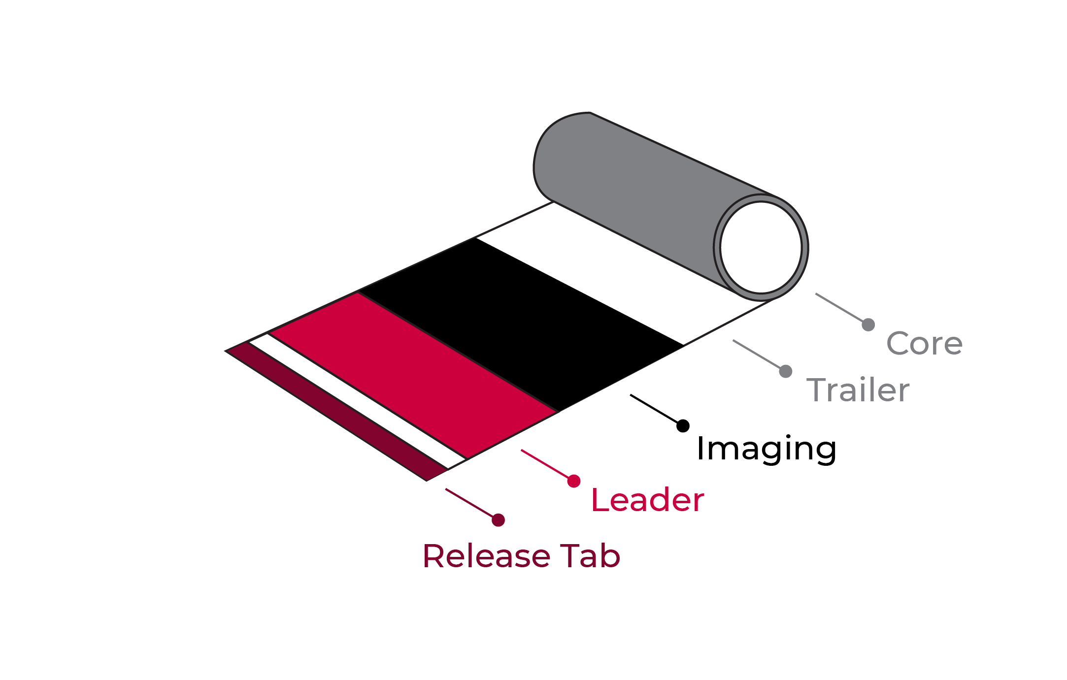
Thermal Transfer
Ribbon Components

Slide 30
Thermal Printer
Configurations
Zebra printers - Ink out (most of the time)
Sato printers - Ink in
Datamax printers - Ink out (most of the time)
Intermec printers - Ink out (most of the time)
TEC printers - Ink out
Eltron printers - Ink out
When in doubt, provide us with the printer make/model to ensure proper ribbon match.
Our ribbons conform to printer OEM specifications.

Slide 31
Ribbon / Label
Compatibility
Ribbon: Wax
Label: Papers
Applications:
box labels
retail tags
ingredient labels
general ticketing
lot tracking
pharmaceutical
labels
Ribbon: Wax/Resin
Label: Mid-range
Synthetics
Applications:
lumber tags
tote labels
horticulture tags
direct packaging
ID tags
Ribbon: Resin
Label: High-end
Synthetics
Applications:
drum labels
hazardous materials labels
jewelry tags
nameplates
sports licensing
CD spine labeling
electronic labels

Slide 32
General Ribbon
Label Recommendations
Ribbon Types / Label Stocks
Wax
Uncoated Tag
Uncoated Paper
Coated Tag
Coated Paper
Gloss Paper
Wax/Resin
Polyethylene
Polypropylene
Polyolefin
Kimdura ®
Tyvek ®
Resins
Gloss Polyester
Matte Polyester
Top Coated Polyester
Polystyrene
Vinyl
Polyamide (Kapton®)
Mylar ® (Polyester)
Durability, Cost, and Label Life increase

Slide 33
Label Width VS
Ribbon Width
Label Width
Recommended Ribbon Width (Inches)
1.5”
2”
3”
3.5”
4”
5”
6”
1.57” (40mm)
2.36” (60mm)
3.15” (80mm) or 3.27” (83mm)
4” (101.6mm)
4.17” (106mm) or 4.33” (110mm)
5.12” (130mm)
6.5” (165.1mm)
Key Note: Thermal ribbon should always be wider than the label, including the liner.

Slide 34
Compliance Labeling
Markets, Applications, and Recommendations
Information Systems
Electrical Distribution
Lawn and Garden
Components, Modems
Peripherals
Printers, Scanners
Motors
Transformers
Breakers
Switches
Safety Labels
Product Identification Labels
Brand Identification Labels
Instruction Labels
Appliances
Automotive
Ribbons
Refrigeration
Air Conditioning, Heating/Cooling
Stoves / Ovens
Washers / Dryers
Battery Labels
Under the Hood Labels
Safety Belt Labels
Resin Formulation
Label Stocks
White, Clear, Silver and Chrome Polyesters

Slide 35
Ribbon
Questions
Typical information gathered when selecting a thermal ribbon:
What is the make and model of the thermal printer being used?
What is the application and what is the expectation?
What is the label material and size?
What type of ribbon is currently being used; wax, wax/resin, resin?
What is the ribbon volume? How many labels used per day/week/month?

Slide 36
Selling

Slide 37
Questions To
Ask Yourself
Why would I want to lead with SELLING LABELS?
Answer: You’re already providing their packaging materials, “Labels Make the Total Package”
Do you currently sell labels to your largest customers?
Answer: Should be YES and if you are not, ask yourself WHY?
Overcome both internal and external challenges that keep you from servicing this everyday need your customer is purchasing with your competition
Do you have any customers in manufacturing, logistics or distribution?
Answer: If yes, TARGET these accounts for large volume label sales
How can I differentiate myself from my competition?
Answer: Offer value and added convenience by limiting their sources for products you can already provide
Offer programs to save your customers money
Listen to your “customer’s pain” and create label and ribbon solutions

Slide 38
How Do I Sell Labels?
Most Important: Be aware of your customers’ needs
Labels are needed EVERYWHERE!
Do your customers receive products?
Do your customers inventory products?
Do your customers manufacture products?
Do your customers ship products?
If YOU are not selling labels to your customer, your COMPETITION IS! What else do you want them to sell YOUR customer?
4 basic questions to be asking your customer:
Explain the application and what is the label being applied to?
What application and service temp will the label be applied?
Environment: Will it be exposed to heat or cold? Humidity and moisture? Will grease, oil, sunlight, caustic chemicals, or other factors affect durability? Does it need to be a permanent label or removable and easily peeled off?
Applying the label: Will this label be affixed by machine or by hand? Is variable imprinting required?

Slide 39
Achieving The
Best Results
Achieving successful results with printed labels is a matter of
both planning and preparation.
Discuss the product with ID Images -- your printing supplier, as early in the process as possible.
Overcome challenges by thinking of them as OPPORTUNITIES!
Product Knowledge
Knowing the questions to ask regarding printers and labels
Pricing
Minimums
Tooling charges
Misconception that there is little margin to be made in selling labels
Open Discussion From Questionnaire Results.

Slide 40
Delivering Expanded Services With Proven Results
We are here to help!
Sales Calls
We will help in supporting with end user calls
You qualify the account
Set up the appointment with their contacts
Products we provide will be quoted
Final step being VITAL is to follow up with customer while its still hot
Qualifying the Account
Role Play
Literature: Customizing marketing collateral
Used for Handouts as leave behinds
E-blasts on new products or promotions
Customized price list with a full list of stock label and ribbon products you can provide
Training
We provide training both here at ID Images as well as your facility

Slide 41
Paper Labels
Segments that use paper labels:
Manufacturing
Distribution
Warehouse
Retail
Healthcare
Food Industries
Your existing customers

Slide 42
Durable Film Labels
End-User Market Applications
Electronics
Appliance-UL approved
Healthcare
Computers & PDA’s
Cell Phones
Circuit Boards
HVAC
Power Tools
White & Brown Goods
Medical Diagnostics
Pharmaceuticals
Bandages
Lawn & Garden
Transportation
Sports & Leisure
Outdoor Power Equipment
Ladders
Furniture
Automotive Underhood
Tires & Batteries
Safety Systems & Interiors
Sports Equipment
Outboard Motors
Toys

Slide 43
Keys To Success
Utilize OUR services to build business together
Identify large users of labels
Warehouse walk-through
Shipping docks
Work in process inventory
Distribution companies
Identify the buyer or decision maker
Purchasing
Operations Manager
Warehouse/Shipping Manager
Information Technology
Compliance Manager
Quality Department
Printer Operators
They are a good source to let you know how the existing product is working which can be difficult to get from Purchasing

Slide 44
Keys To Success
Build relationships by Knowing Your Customers’ Needs
Offer one of our Cost-Savings Programs outlining their benefits
We are happy to provide free stock samples
For custom sizes, we will work with you
We can service national accounts
“Win” one facility and target the rest

Slide 45
Marketing Services
Your Dedicated Distribution Partner
Building Business Together

Slide 46
Marketing Services
We Offer a Range of Marketing Services:
Marketing Collateral
Product / Market Sell Sheets
Product Catalogs
eMarketing Campaigns
Product Promotions
Informational Campaigns
Public Relations
Success Stories
News Releases
Creative & Other Services
Design
Images (print & web applications)

Slide 47
Marketing Services
Benefits of our Marketing Services:
Tools to Assist in the Selling Process
Educate Your Customers
Build Awareness and Credibility
Effective Method to Stay in Front of Customer
Track and Measure Success (eMarketing)
Tailor Information Based on Customer Type
SELL MORE LABELS & RIBBONS

Slide 48
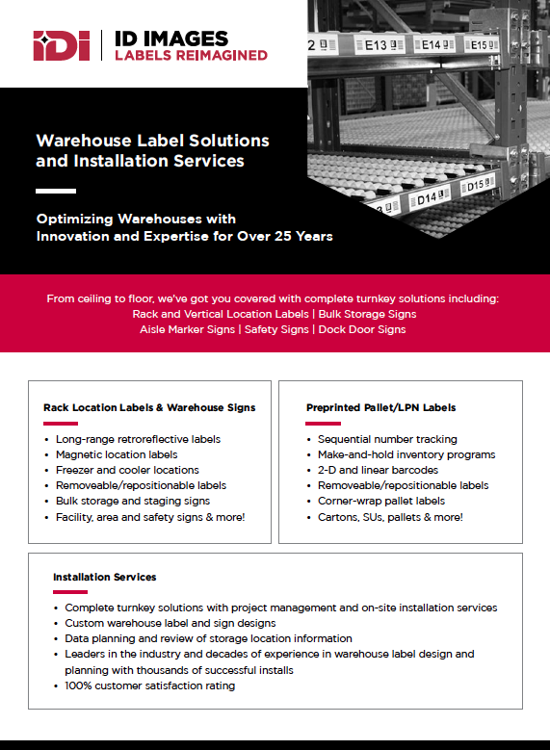
Marketing Collateral
Logo
Generic Product Sell Sheet
Company Logo
Customize content based on need
Company Contact Information

Slide 49
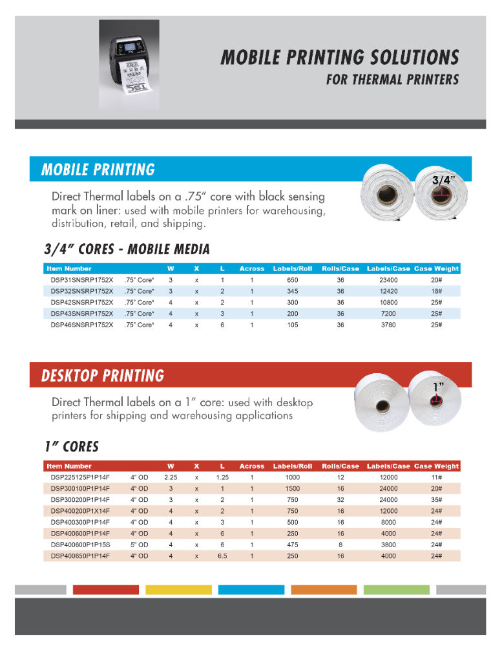
Marketing
Collateral
Customized brochure to promote specific product, service or capability.

Slide 50
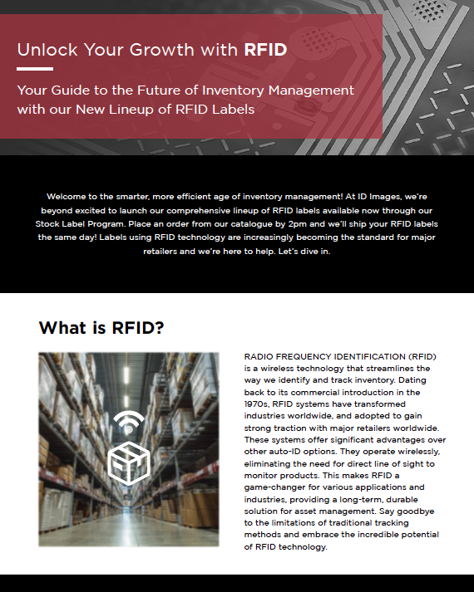
Marketing
Collateral
Specialty Brochures
Customized message & images

Slide 51
Marketing Services
What’s needed to get started
Collateral
High Resolution Company Logo
Contact Information
Objective and Audience
Message and Take Away
Email Marketing
Same as Above
Customer Database (excel)
Email address
First name

Slide 52
Thank You
Call or email ID Images today 866.516.7300 customerservice@idimages.com www.idimages.com

